Slide 1

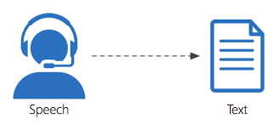
Azure Cognitive Service
Speech to Text
Broadview Consulting

Slide 2
What will you learn?
Speech and Text analytics cognitive service
Speech Recognition via Web App
Version control and deployment
Building Sentiment Analysis
Notes:
Configure speech and text services in azure for solving a business problem
How to use the built speech and text services in form of a web application
How to keep your version of your previous code and maintenance in continuous deployment- rollback; maintaining continuous inflow and outflow of changes
Batch form

Slide 3
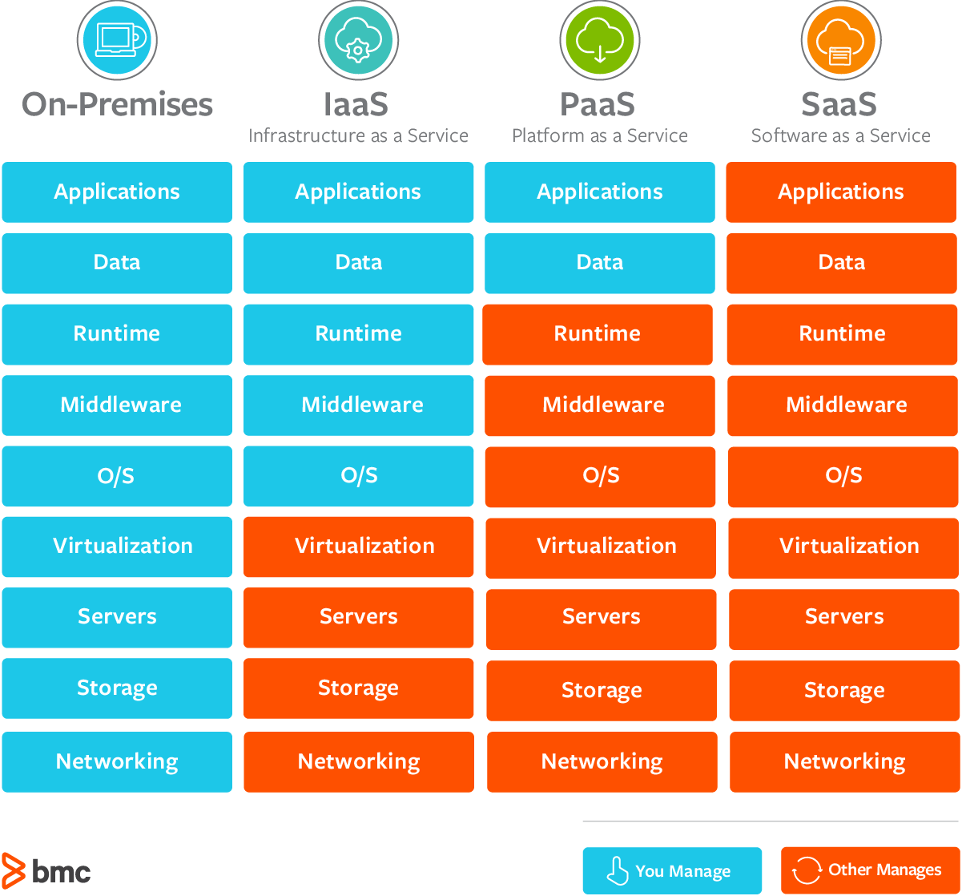
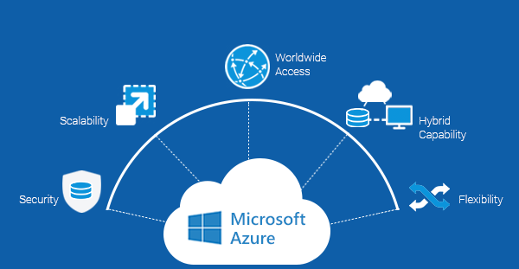
Cloud Services

Slide 4
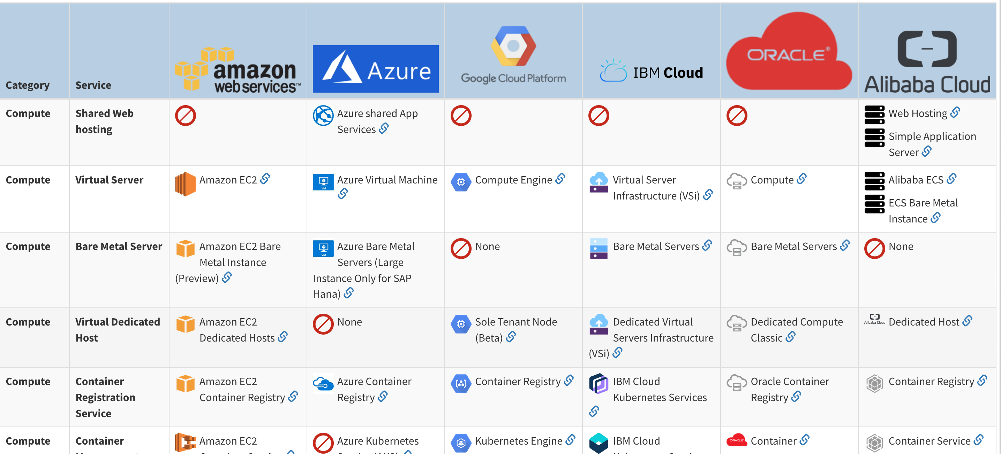
Why Microsoft Azure?

Slide 5
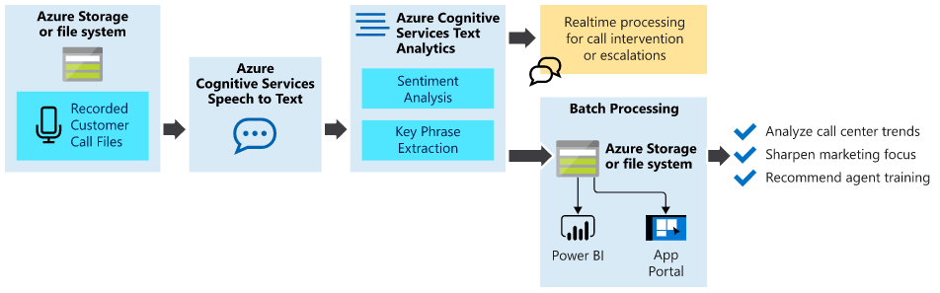
Analyze inbound customer calls

Slide 6

Commoditizing AI
Deep Learning
Reinforcement Learning
NLP
Agile in AI

Slide 7
Speech Recognition
Computational linguistics
Hidden Markov Model
Acoustic modeling
Geoffrey Hinton
Voice Assistant
Notes:
https://en.wikipedia.org/wiki/Speech_recognition#:~:text=Modern%20general%2Dpurpose%20speech%20recognition,a%20short%2Dtime%20stationary%20signal.

Slide 8
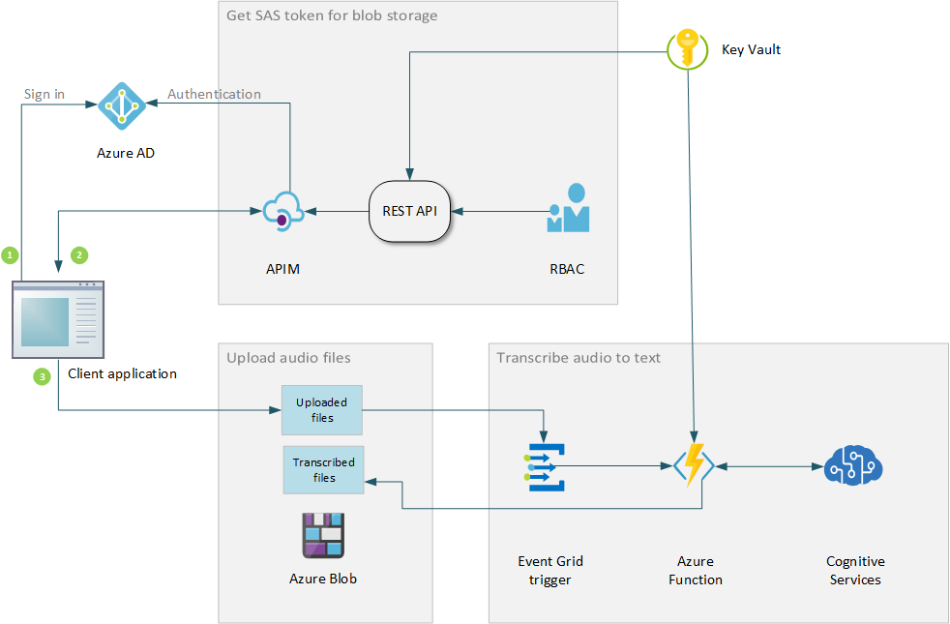
Cognitive Service Reference Architecture
Azure AD Authentication
RBAC
Azure Function
Trigger
BLOB Storage
Rest API
Cognitive Service
Notes:
https://docs.microsoft.com/en-us/azure/architecture/reference-architectures/ai/speech-ai-ingestion

Slide 9
Azure Subscription
Microsoft Account
Free account
Resource Group
Azure for Student

Slide 10

Speech Service Text Analytics Service App Service Deployment – CI/CD Version Control- GitHub ML Studio

Slide 11
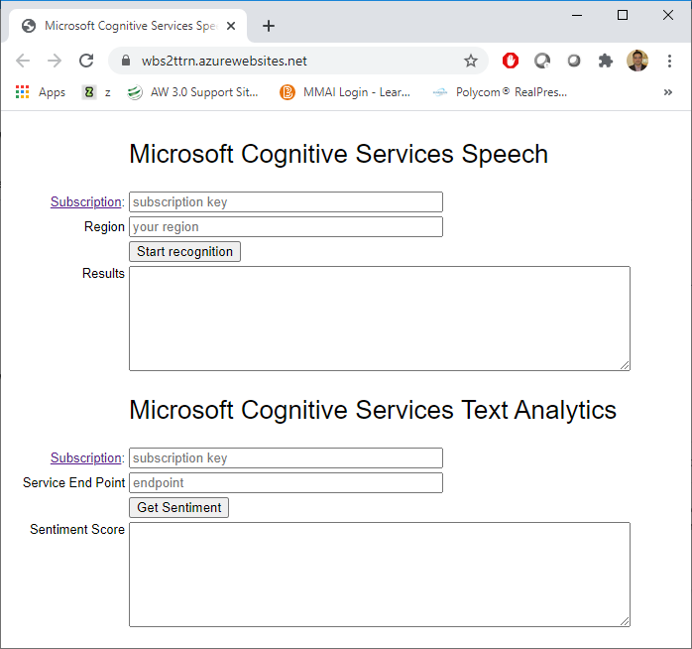
Real-time Sentiment Check
Copy Code to Local folder
Save in GitHub
Setup Deployment
CI/CD pipeline pushes the change to Azure
Enter the subscription key and Region
Browse the URL https://your_web_app_name.azurewebsites.net
GitHub link- https://github.com/BroadviewQueens/Speech2Text
Notes:
Copy below files:
index_from_microphone.html
microsoft.cognitiveservices.speech.sdk.bundle.js
token.php

Slide 12
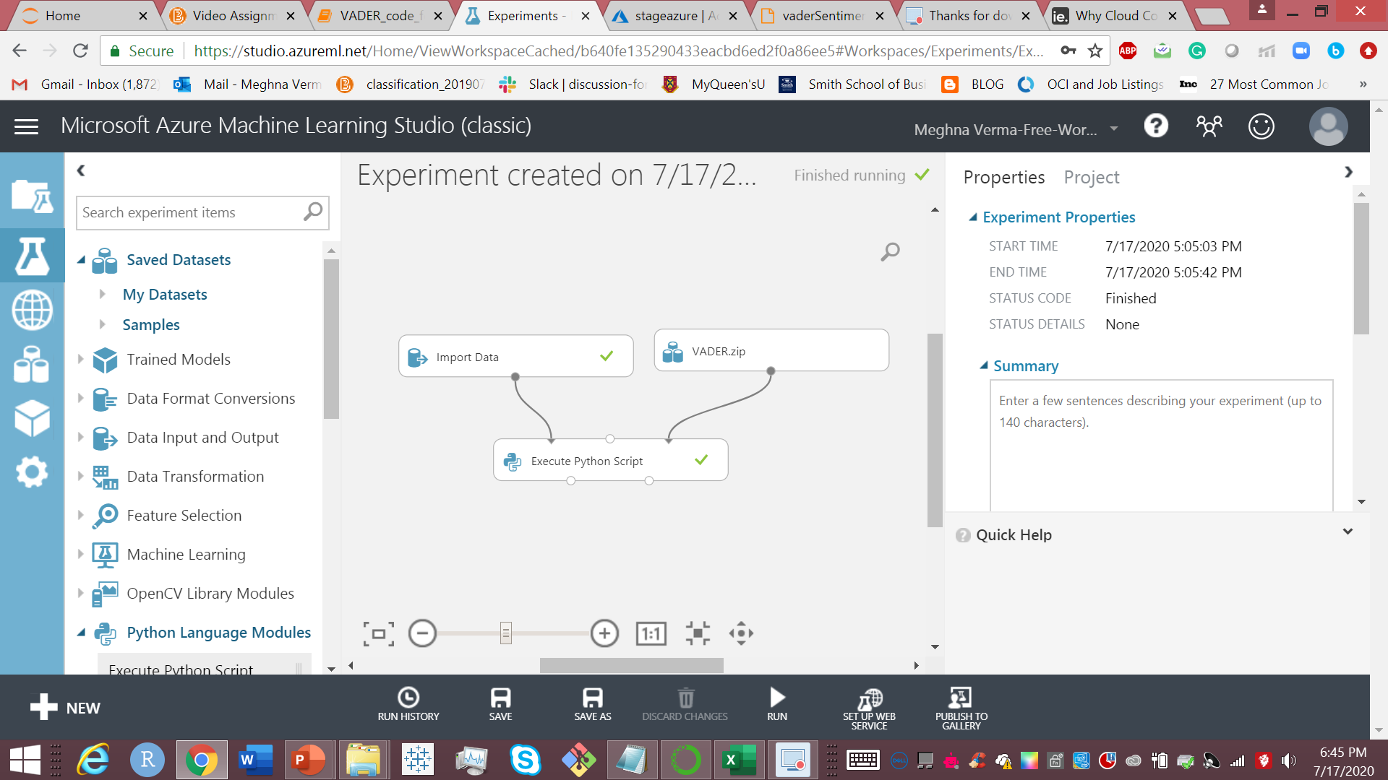
Machine Learning Studio
Upload dataset in Azure Blob Storage
Import dataset
Connect data and zip folder with python script module
Visualize Results
Notes:
https://aliheikal.com/build-a-web-based-mood-analyzer-using-azure-text-analytics-api/
https://cloud.google.com/solutions/machine-learning/categorizing-audio-files-using-ml
https://www.youtube.com/watch?v=ic-eP-gtFSo

Slide 13
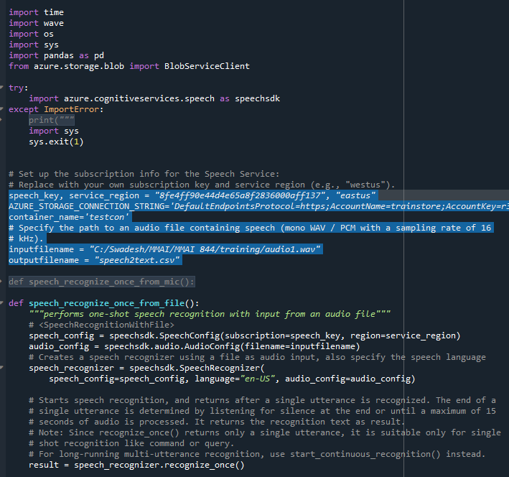
Python demo
Storage Account
Container
Storage Key
Speech-to-text key
Region
azure.cognitiveservices.speech
azure.storage.blob
Notes:
pip install azure.cognitiveservices.speech
pip install azure.storage.blob

Slide 14
Need Help ?
Website: https://swadeshmisra2020.wixsite.com/broadview/training
Contact Us:
Meghna Verma - 19mv6@queenus.ca
Swadesh Misra - swadesh.misra@queensu.ca

Slide 15
THANK YOU

Slide 16

Appendix
Activate student account-
https://azure.microsoft.com/en-us/free/students/

